Slide 1
STOR 455 Two-Way ANOVA
Read: 6.3-6.5, 7.1-7.6, 8.7
Exercises: 6.38, 7.34

Slide 2
Extra Credit Homework
2% of course grade.
Due 04/30 11:55pm. Late submission will not receive extra credit.
Submit your Rmd file with codes and answers through Sakai Assignments.
24 questions from the textbook. Data from Stat2Data package.
Yes, the solutions are all in your textbook.
For your own benefit, it could be a good exercise if you work out the problems first and then check with the solutions.

Slide 3
Example: Exam Scores
Barb Betsy Bill Bob Bud
Mean
72
87
68
73
75
Exam #1:
Exam #2:
Exam #3:
Exam #4:
62 94 68 86 50
87 95 93 97 63
74 86 82 70 28
77 89 73 79 47
Mean 75 91 79 83 47
We’ve shown (one-way):
No significant differences between the exams
Significant differences between the students
Question: Can we use BOTH factors to help explain the variability in the exam scores?

Slide 4
Simple Block Design
Definition: A simple block design has two factors with exactly one data value in each combination of the factors.
Assume: Factor A (Treatments) has K levels
Factor B (Blocks) has J levels
⇒ n= K∙J data values

Slide 5
Two-way ANOVA: Main Effects Model
Grand Mean
Random error
Effect for k^{th} treatment
Effect for j^{th} block

Slide 6
Randomize Block - Calculations
Find the mean for each treatment (row means), each block (column means), and grand mean.
Partition the SSTotal into three pieces:
(as usual)
(row means)
(column means)

Slide 7
Randomized Block ANOVA Table
K−1
SSA
SSA/(K-1)
MSA/MSE
J−1
SSB
SSB/(J-1)
MSB/MSE
(K-1)(J-1)
SSE
SSE/(K-1)(J-1)
n-1
SSTotal
Testing TWO hypotheses:
H_{o}: α₁ = α ₂=...= α_{K}=0
H_{a}: Some α _{k} ≠0
(Factor A: Difference in treatment means?)
H_{o}: β₁ = β ₂=...= β_{J}=0
H_{a}: Some β _{j} ≠0
(Factor B: Difference in block means?)

Slide 8
Two-way ANOVA on R
amodA=aov(Grade~factor(Exam),data=Exams4)
summary(amodA)
Df Sum Sq Mean Sq F value Pr(>F)
factor(Exam) 3 1030 343.33 1.0564 0.395
Residuals 16 5200 325.00
amodB=aov(Grade~Student,data=Exams4)
summary(amodB)
Df Sum Sq Mean Sq F value Pr(>F)
Student 4 4480 1120.00 9.6 0.0004676 ***
Residuals 15 1750 116.67
amodC=aov(Grade~factor(Exam)+Student,data=Exams4)
summary(amodC)
Df Sum Sq Mean Sq F value Pr(>F)
factor(Exam) 3 1030 343.33 5.7222 0.01144 *
Student 4 4480 1120.00 18.6667 4.347e-05 ***
Residuals 12 720 60.00
aov(Y~FactorA+FactorB,data= )
Evidence of a difference in means between exams.
Evidence of a difference in means between students.

Slide 9
TukeyHSD(amodAB)
Tukey multiple comparisons of means
95% family-wise confidence level
Fit: aov(formula = Grade ~ factor(Exam) + Student)
$`factor(Exam)`
diff lwr upr p adj
2-1 15 0.4554143 29.5445857 0.0425678
3-1 -4 -18.5445857 10.5445857 0.8455825
4-1 1 -13.5445857 15.5445857 0.9968212
3-2 -19 -33.5445857 -4.4554143 0.0102092
4-2 -14 -28.5445857 0.5445857 0.0605331
4-3 5 -9.5445857 19.5445857 0.7409734
$Student
diff lwr upr p adj
Betsy-Barb 16 -1.458285 33.458285 0.0782719
Bill-Barb 4 -13.458285 21.458285 0.9451946
Bob-Barb 8 -9.458285 25.458285 0.6039841
Bud-Barb -28 -45.458285 -10.541715 0.0019421
Bill-Betsy -12 -29.458285 5.458285 0.2467758
Bob-Betsy -8 -25.458285 9.458285 0.6039841
Bud-Betsy -44 -61.458285 -26.541715 0.0000293
Bob-Bill 4 -13.458285 21.458285 0.9451946
Bud-Bill -32 -49.458285 -14.541715 0.0006169
Bud-Bob -36 -53.458285 -18.541715 0.0002093

Slide 10
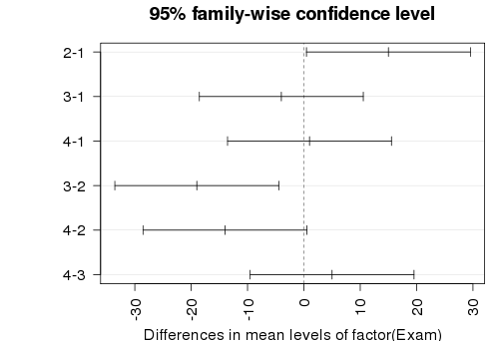
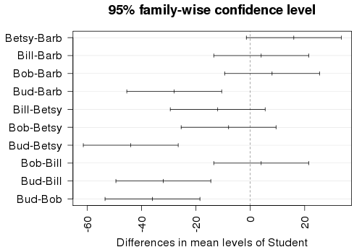
par(mar=c(4,7,3,1))
hsd=TukeyHSD(amodC)
plot(hsd,las=2)
par(mar=c(5,4,2,2))

Slide 11
What’s an Interaction Effect?
An interaction effect occurs when a significant difference is present at a specific combination of factors.
Example: Y=GPA
Factor A = Year in School (FY, So, Jr, Se)
Factor B = Major (Psych, Bio, Math)
FY is hard?
⇒ α₁ < 0 (main effect)
Bio is easy?
⇒ β₂ > 0 (main effect)
Jr in Math is hard?
⇒ γ₃₃ < 0 (interaction effect)

Slide 12
Factorial Design
Assume: Factor A has K levels, Factor B has J levels.
To estimate an interaction effect, we need more than one data value in each combination of factors.
Let n_{kj} = sample size in (k,j)^{th} cell
Def: For a balanced design, n_{kj} is constant for all cells.
c = 1 ⇒ randomized block design
c > 1 ⇒ balanced factorial design
n_{kj} = c

Slide 13
Example: Glue Strength
Factor A: Thickness (thin, moderate, heavy)
Factor B: Glue Type (plastic, wood)
Response: Force required to separate parts (newtons)
Data: | Plastic | Wood
Thin | 52 64 | 72 60
Moderate | 67 55 | 78 68
Heavy | 86 72 | 43 51
K= 3
J = 2
c = 2
n = 12

Slide 14
Two-way ANOVA Table (with interaction)
Source | d.f. | S.S. | M.S. | t.s. | p-value
Factor A | K-1 | SSA | SSA/(K-1) | MSA/MSE
Factor B | J-1 | SSB | SSB/(J-1) | MSB/MSE
A x B | (K-1)(J-1) | SSAB | SSAB/df | MSAB/MSE
Error | JK(c-1) | SSE | SSE/df
Total | n-1 | SSY
H_{o}: All α_{k} = 0
H_{A}: Some α_{k} ≠ 0
H_{o}: All β_{J} = 0
H_{A}: Some β_{J} ≠ 0
H_{o}: All γ_{kj} =0
H_{A}: Some γ_{kj} ≠ 0

Slide 15
Two-way ANOVA Table (with interaction)
Source | d.f. | S.S. | M.S. | t.s. | p-value
Factor A | 2 | 56 | 28.0 | 0.42 | 0.672
Factor B | 1 | 48 | 48.0 | 0.73 | 0.426
A x B | 2 | 1184 | 592.0 | 8.97 | 0.016
Error | 6 | 396 | 66.0
Total | 11 | 1684
H_{o}: All α_{k} = 0
H_{A}: Some α_{k} ≠ 0
H_{o}: All β_{J} = 0
H_{A}: Some β_{J} ≠ 0
H_{o}: All γ_{kj} =0
H_{A}: Some γ_{kj} ≠ 0
No main effects, but there is some interaction effect.

Slide 16
Interpreting Interaction
IF the two-way ANOVA indicates a significant interaction, plot the cell means vs. one factor with separate lines/symbols for the second factor
Called a Cell means plot or Interaction plot
Cell Means: | Plastic | Wood
Thin | 58.0 | 66.0
Moderate | 61.0 | 73.0
Heavy | 79.0 | 47.0
interaction.plot(FactorA,FactorB,Response)

Slide 17
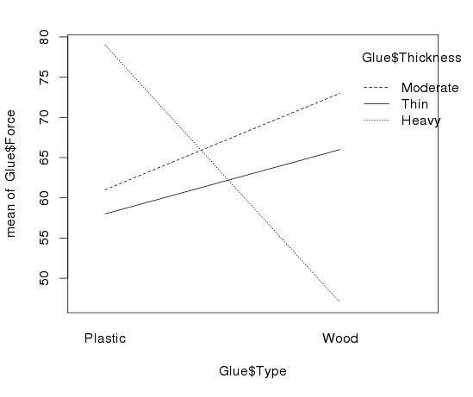
Interaction Plot via R
> interaction.plot(Glue$Type,Glue$Thickness,Glue$Force)
> interaction.plot(FactorA,FactorB,Y)

Slide 18
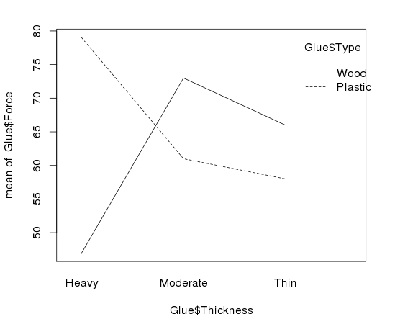
> interaction.plot(Glue$Thickness,Glue$Type,Glue$Force)

Slide 19
Checking Conditions for ANOVA
Check with residuals
Zero mean:
Always holds for sample residuals
Constant variance:
Plot residuals vs. fits and/or compare std. dev.’s of groups
(Check if some group s_{i} is more than twice another)
Normality:
Histogram/normal plot of residuals
Independence:
Pay attention to data collection

Slide 20
Example: Five Students
Barb Betsy Bill Bob Bud
Exam #1:
Exam #2:
Exam #3:
Exam #4:
62 94 68 86 50
87 95 93 97 63
74 86 82 70 28
77 89 73 79 47
Mean 75.0 91.0 79.0 83.0 47.0
Is there a significant difference in average grade among the five students?

Slide 21
ANOVA for Grades vs. Students
> tapply(Exams4$Grade,Exams4$Student,mean)
Barb Betsy Bill Bob Bud
75 91 79 83 47
> round(tapply(Exams4$Grade,Exams4$Student,sd),2)
Barb Betsy Bill Bob Bud
10.30 4.24 10.98 11.40 14.45
> modS=aov(Grade~Student,data=Exams4)
> summary(modS)
Df Sum Sq Mean Sq F value Pr(>F)
Student 4 4480 1120.0 9.6 0.000468 ***
Residuals 15 1750 116.7
Can we assume equal variances?

Slide 22
Levene’s Test for Equality of Variances
=
+
Conduct analysis of variance on the collection of absolute deviations.
Median of group k

Slide 23
Example: Five Students
Barb Betsy Bill Bob Bud
62 94 68 86 50
87 95 93 97 63
74 86 82 70 28
77 89 73 79 47
Median 75.5 91.5 77.5 82.5 48.5
> tapply(Exams4$Grade, Exams4$Student,median)
Barb Betsy Bill Bob Bud
75.5 91.5 77.5 82.5 48.5

Slide 24
Levene’s Test for Grades versus Students
medians=rep(tapply(Exams4$Grade, Exams4$Student,median),each=4)
Barb Barb Barb Barb Betsy Betsy Betsy Betsy Bill Bill Bill
75.5 75.5 75.5 75.5 91.5 91.5 91.5 91.5 77.5 77.5 77.5
Bill Bob Bob Bob Bob Bud Bud Bud Bud
77.5 82.5 82.5 82.5 82.5 48.5 48.5 48.5 48.5
LeveneData=abs(Exams4$Grade-medians)
LeveneData
Barb Barb Barb Barb Betsy Betsy Betsy Betsy Bill Bill
13.5 11.5 1.5 1.5 2.5 3.5 5.5 2.5 9.5 15.5
Bill Bill Bob Bob Bob Bob Bud Bud Bud Bud
4.5 4.5 3.5 14.5 12.5 3.5 1.5 14.5 20.5 1.5

Slide 25
Levene’s Test for Grades versus Students
Levene_aov = aov(LeveneData~Exams4$Student))
summary(Levene_aov)
Df Sum Sq Mean Sq F value Pr(>F)
Exams4$Student 4 88.8 22.20 0.567 0.69
Residuals 15 587.0 39.13
library(car)
leveneTest(Exams4$Grade, Exams4$Student)
Levene's Test for Homogeneity of Variance (center = median)
Df F value Pr(>F)
group 4 0.5673 0.6903
15

Slide 26
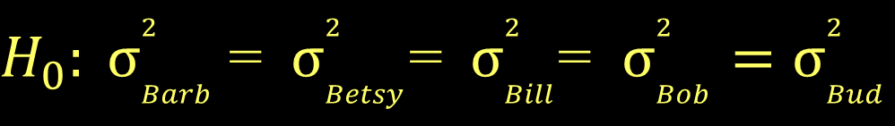
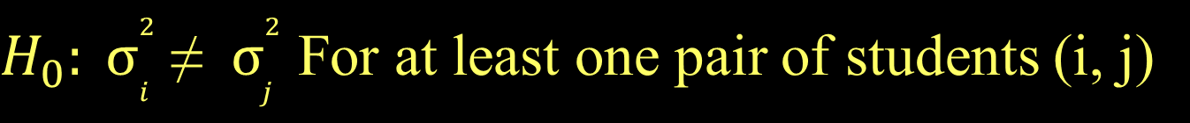
Levene’s Test for Grades versus Students
$H_{0}: σ_{Barb}^{2}$= $σ_{Betsy}^{2}$=$σ_{Bill}^{2}$= $σ_{Bob}^{2}=σ_{Bud}^{2}$
$H_{0}: σ_{i}^{2}$≠ $σ_{j}^{2}$ For at least one pair of students (i, j)
Levene's Test for Homogeneity of Variance (center = median)
Df F value Pr(>F)
group 4 0.5673 0.6903
15
There is not statistically significant evidence to suggest that students’ grades have difference variances.

